Slide 1


UNIVERSITY OF BASRA
COLLEGE OF MEDICINE
DEPARTMENT OF PATHOLOGY AND FORENSIC Medicine
Bleeding Disorders
Dr. Ala’a A.Razak Abood
Iraqi Board of Haematopathology

Slide 2
Learning Objectives:
To understand how our vascular system keep our blood in its fluid state.
To know how bleeding is arrested.
To define the components of the heamostasis and know their role.
classify the bleeding disorders and give an example on each.

Slide 3
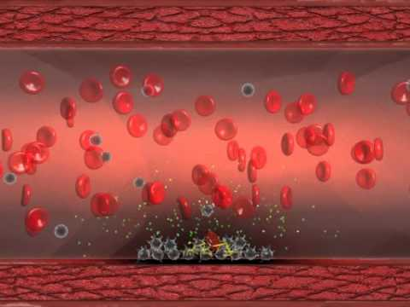
Haemostasis:
Is a process which cause bleeding to stop
Initiation
Termination
Removal

Slide 4
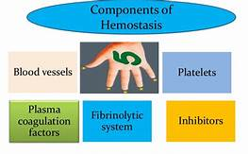
Components of the haemostatic response :

Slide 5
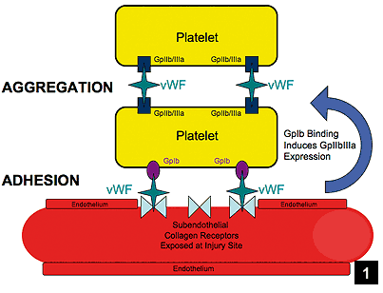
Platelet Function:
Platelet adhesion , aggregation and release reaction

Slide 6
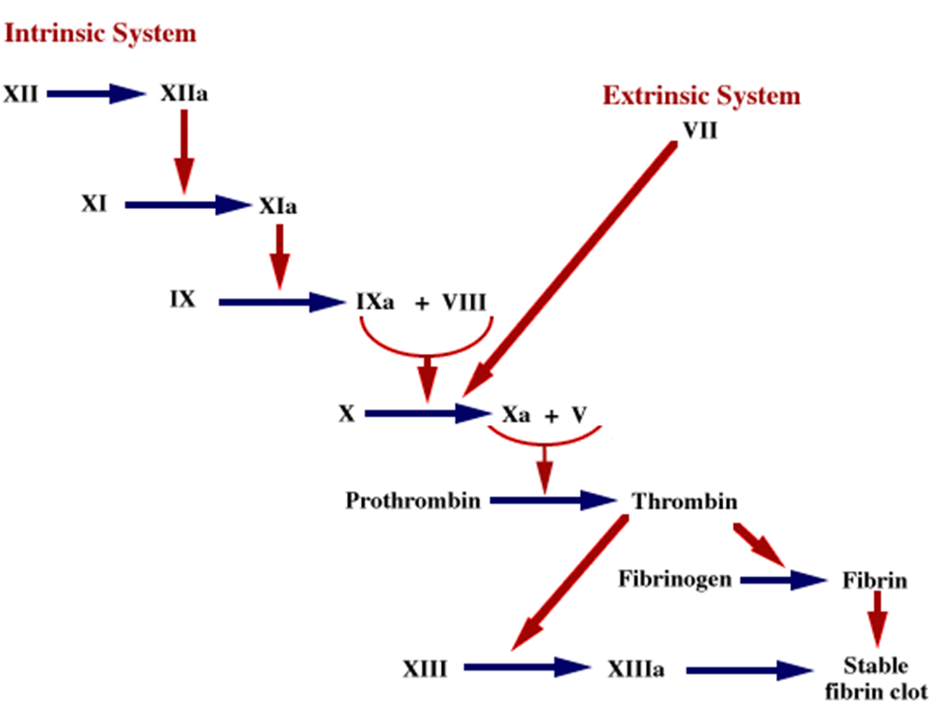
The coagulation cascade:

Slide 7
Classification of Abnormal Bleeding
Vascular disorders
Coagulation disorders
Platelet disorders

Slide 8
Vascular disorders
inherited
acquired
1- Hereditry haemorrhagic telentectasia
2- Ehlaers-Danlos syndrome
1-Senile purpura
2-Henoch-Sconlein purpura

Slide 9
Platelet disorders
Thrombocytopenia
Disorders of platelet function
1- ITP
2- Bone marrow failure
1- Glanzmann’s disease
2- Bernard-Soulier syndrome

Slide 10
Coagulation disorders
Hereditary coagulation disorders
Acquired coagulation disorders
1- Haemophilia
2- Von Willebrand disease
1- Vit. K deficency
2- Liver disease
3- Oral anticoagulant
4- DIC

Slide 11
Immune thrombocytopenic purpura:
- It is a disorder that can lead to easy or excessive bruising and bleeding due to low PLT count secondary to excessive PLT destruction.
- Either acute or chronic.
- Primary or secondary.

Slide 12
Chronic idiopathic thrombocytopenic purpura:
Pathogenesis:
PLT autoantibodies (IgG) premature PLT removal

Slide 13
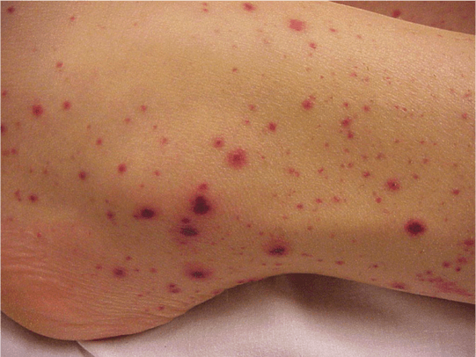
Clinical features:
Bleeding tendancy: petechial haemorrhage, easy bruising, menorrhagia.

Slide 14
Diagnosis:
1. Low PLT count (10-100 × 10⁹)
2. Blood film: thrombocytopenia with remaining large one.
3. Bone morrow : normal or increased number of megakaryocytes.
4. Specific tests: antiglycoprotein Abs.

Slide 15
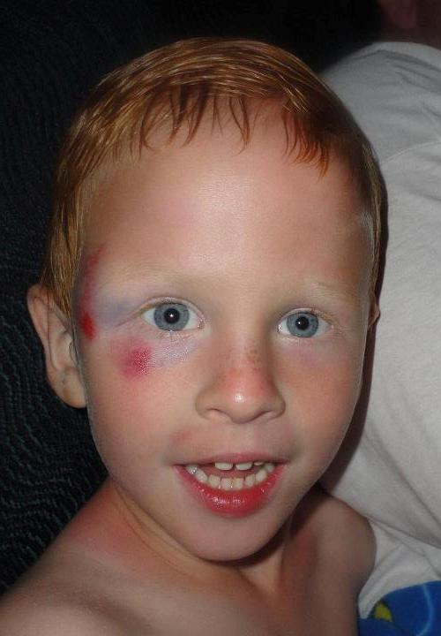
Acute idiopathic thrombocytopenic purpura:
children.
Follow vaccination or infection.
Non specific immune complex.
Spontaneous remission.

Slide 16
Haemophilia A :
- It is the most common hereditary clotting factor deficiency (factor VIII deficiency).
- Sex linked disease.

Slide 17
Clinical features:
Post circumcision
haemorrhage.
Joints and soft tissue
bleeds.
Excessive bruising.

Slide 18
Laboratory Findings:
1- Prolonged Activated partial thromboplastin time (APTT).
2- Factor VIII clotting assay :
reduced or absent F VIII.

Slide 19
Clinical differences between PLT/ Vessel wall diseases and coagulation factors diseases:

Slide 20
Disseminated intravascular coagulation
Definition and Pathogenesis:
Widespread inappropriate intravascular deposition of
fibrin with consumption of coagulation factors and platelets occurs as a consequence of many disorders that release procoagulant material into the circulation or cause widespread endothelial damage or platelet aggregation

Slide 22
Causes :
1- infection.
2- malignancy.
3- obstetric complication.
4- hypersensitivity reaction.
5- wide spread tissue damage.
6- vascular abnormality
7- miscellaneous.

Slide 23
Clinical features:
- Bleeding
Microthrombi

Slide 24
Laboratory findings:
* Tests of haemostasis
1- The platelet count is low.
2- Fibrinogen concentration is low.
3- The thrombin time is prolonged.
4- High levels of fibrin degradation products such as D‐dimers are found in serum and urine.
5- The PT and APTT are prolonged in the acute syndromes.
* Blood film examination
In many patients there is a haemolytic anaemia (‘microangiopathic’)
and the red cells show prominent fragmentation

Slide 25
Interpretation of screening tests in bleeding disorders:
PT | APTT | Fibrinogen assay | Platelets counts | Condition
N | N | N | N | Normal haemostasis Plat. Function disorders Factor XIII deficiency Mild VWD
Long | N | N | N | FVII deficiency Early oral anticoagulant
N | Long | N | N | Haemophilia A or B VWD
Long | Long | N | N | Vit. K deficiency Oral anticoagulant FV, X or II deficiency Liver failure
N | N | N | Low | ITP
Long | Long | Low | Low | DIC

Slide 26
Column B | Column A
A- Warfarin B- Henoch-Schonlein syndrome C- DIC D- ITP E- Senile purpura F- Glanzmann’s disease G- Haemophilia A | 1- Acute pancreatitis 2- Factor VIII deficiency 3- Hereditary coagulation disorders 4- Acquired vascular disorders

Slide 27


